Slide 1
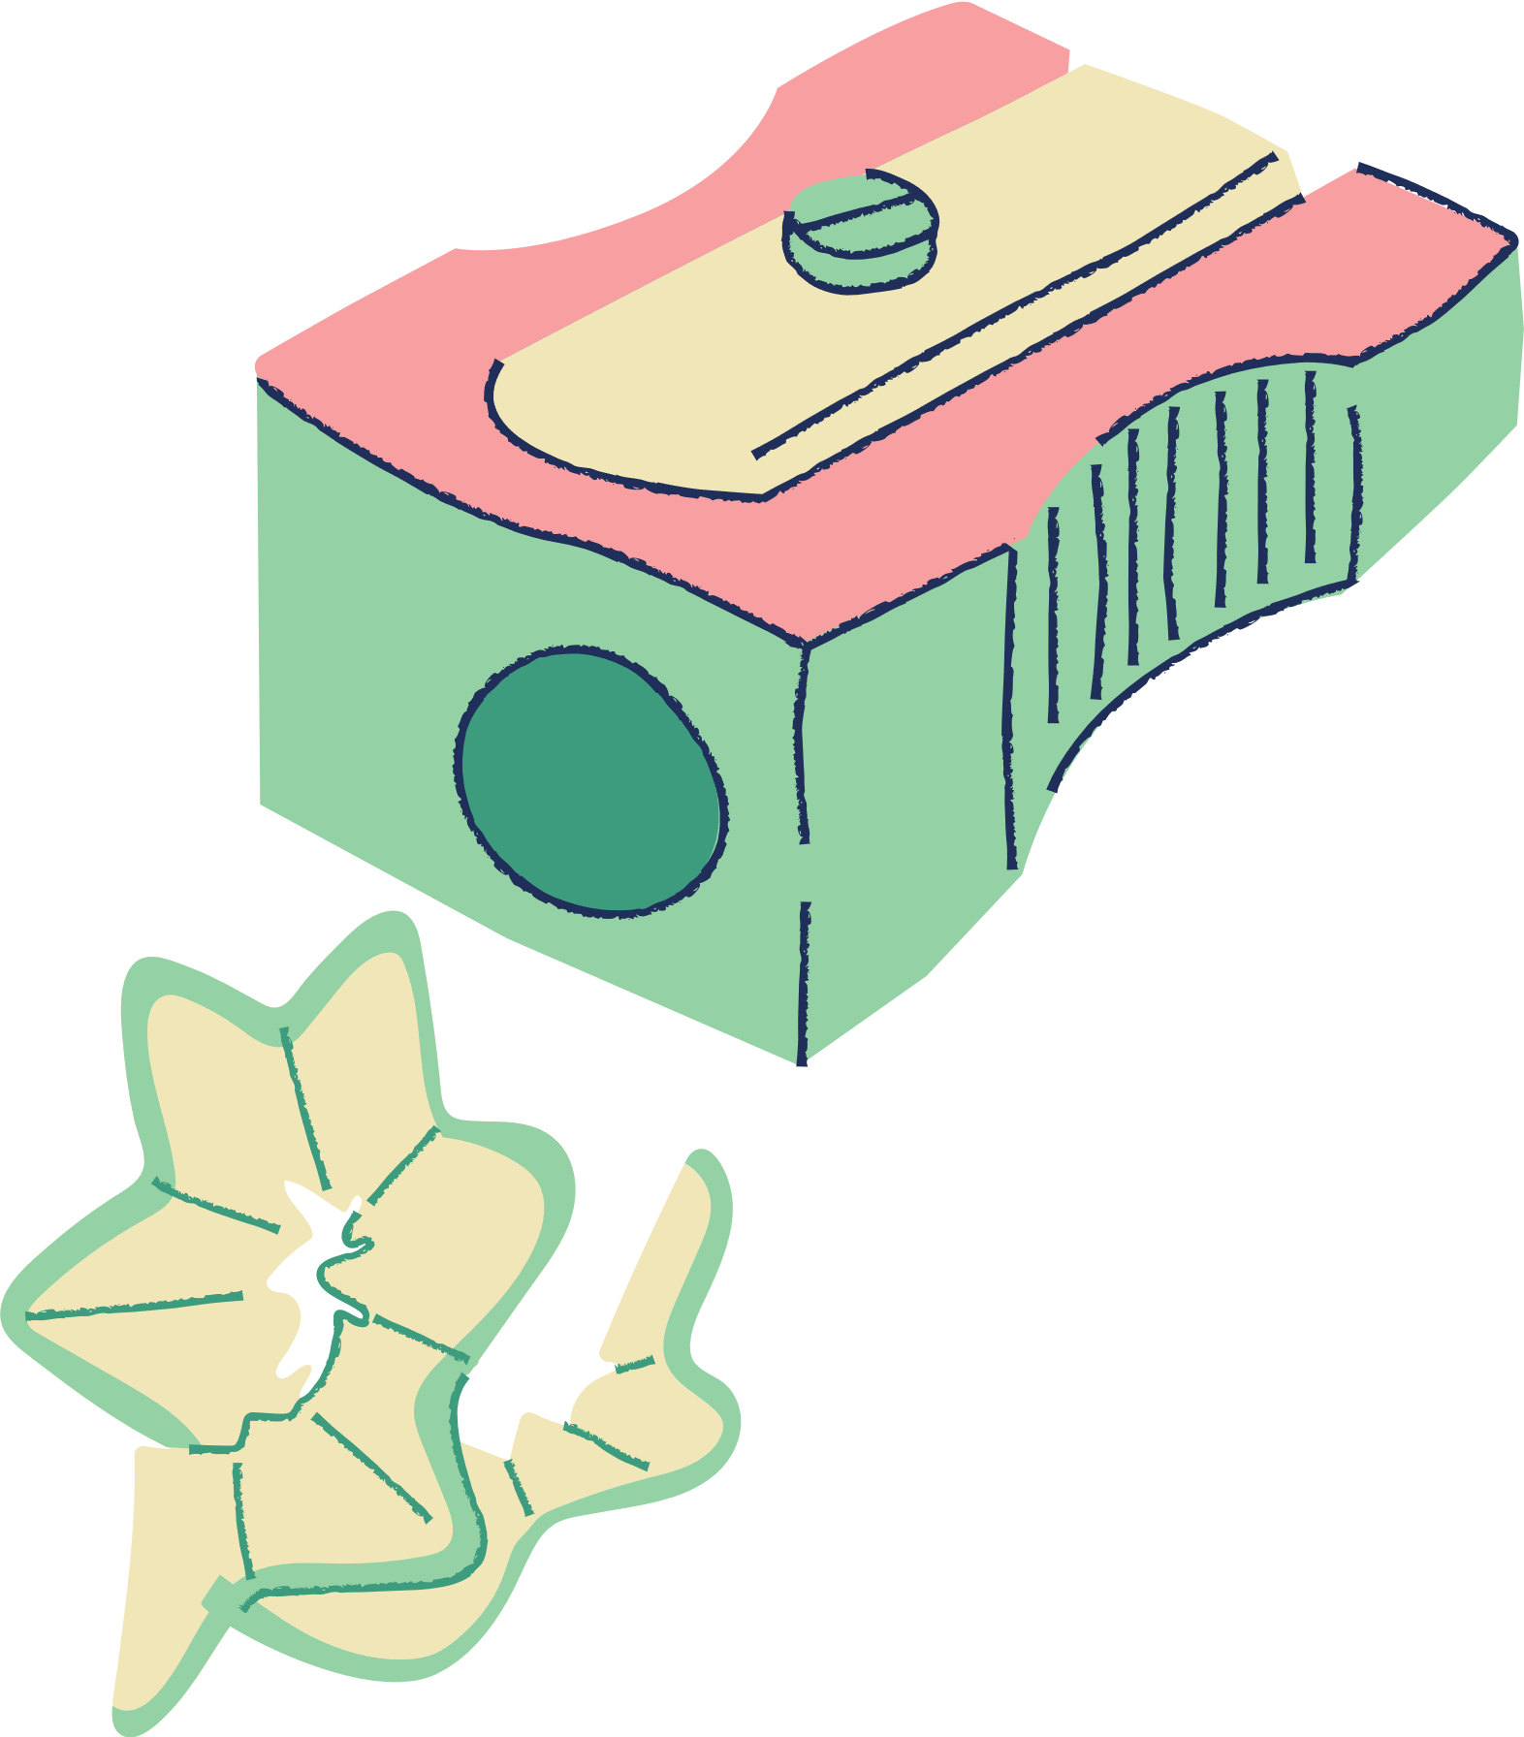





WELCOME TO BRYONY CLASS

Slide 2
WHAT TO EXPECT IN YEAR ONE.
A mixture of continuous provision and formal teaching.
Transition for Arum.
Playtimes an lunch times.
Daily timetable which will change through out the year.
On website updates of photographs and termly news.
A newsletter each term to inform you of any changes to the timetable.

Slide 3

KEY SKILLS FOR YEAR 1
Phonics and reading. (Little wandle)
Reading and building fluency (Books)
Letter formation, sentence structure and punctuation.
Number recognition, addition and subtraction and measurement. (white rose)

Slide 4
SUPPORTING CHILDREN AT HOME.
  Reading with children.
  Encouraging writing and story telling.
  Practising maths skills through everyday activities.

Slide 5
COMMUNICATION WITH TEACHER
  Always here!
  Emailing the office
  Speaking with me (preferably at the end of the day but available in the mornings also.)
  Parents meetings at the end of this term.

Slide 6

SUPPORTING CHILDREN’S WELL BEING.
  Jigsaw
  Zones of regulation.
  Thrive training

Slide 7
RESOURCES FOR PARENTS.
  All resources will be made available on the class page on the school website.

Slide 8
ANY QUESTIONS?

Slide 9
THANKS FOR COMING!

