Slide 1
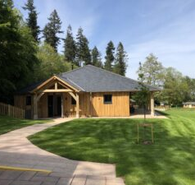

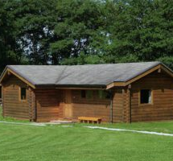
Elder’s Trip to Greatwood Camp
Wed 18th-Friday 20th March
2026

Slide 2
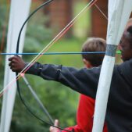
Activities
Archery
Night line
Night walk
Team building activities & other adventurous activities
Stream study
Building a camp fire (wood collecting)
Tracking and trailing

Slide 3
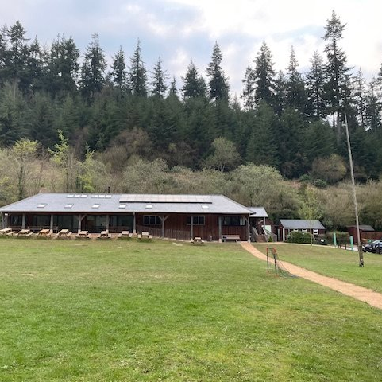
Timetable – Day 1
Assemble in the hall at normal school drop off.
Leave for Greatwood by coach at 9.30am.
Arrive at Tropiquaria Zoo around 11am.
Time to explore.
Lunch (please bring a packed lunch – all disposable)
More time to explore
Arrive at Greatwood about 1.30pm
Tour of the site.
Activity 1
Downtime
Evening meal
Night walk

Slide 4
Timetable – Day 2
Breakfast at 8.30am
Activity 1
Break – biscuit and squash
Activity 2
Lunch
Activity 3 & 4
Break – cake and squash
Downtime
Evening meal
Campfire

Slide 5
Timetable – Day 3
Breakfast at 8.30am
Packing up
Tracking and trailing
Lunch
Leave for home 1.30pm.
Arrive home around 3-3.30pm.

Slide 6
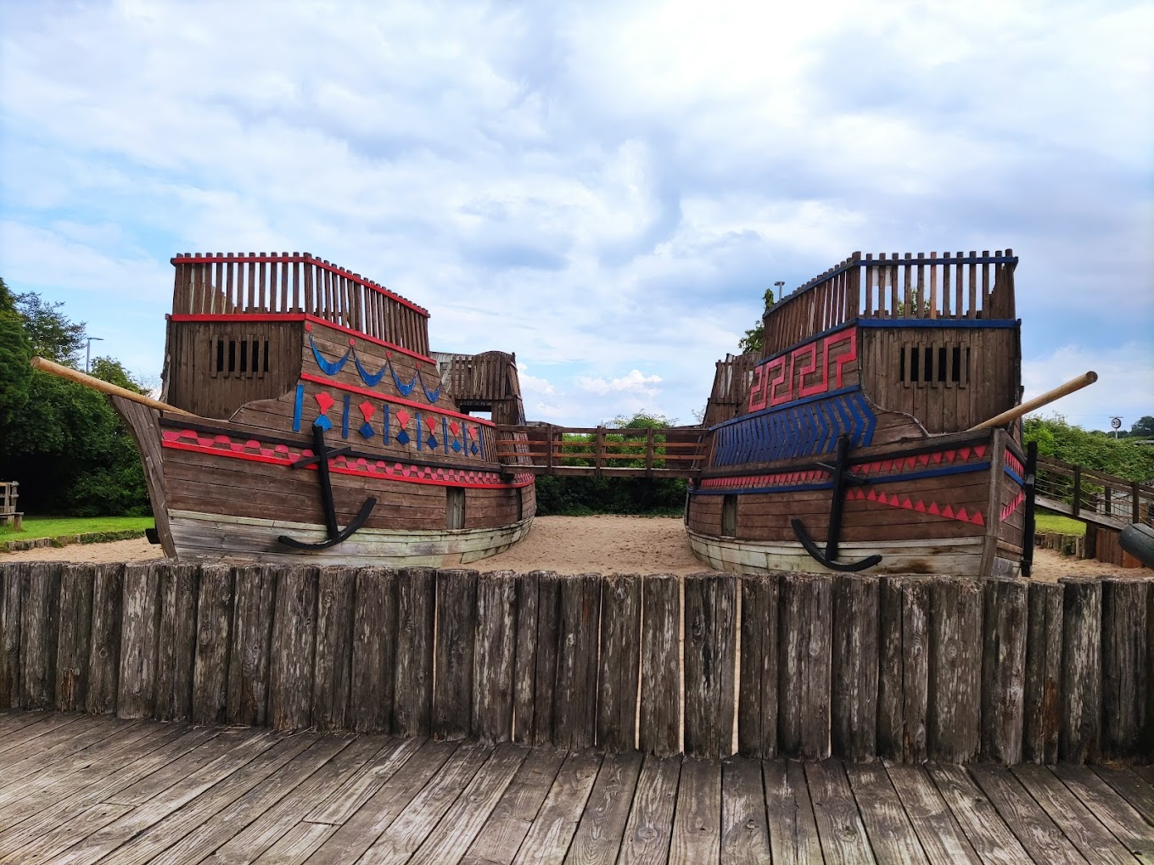
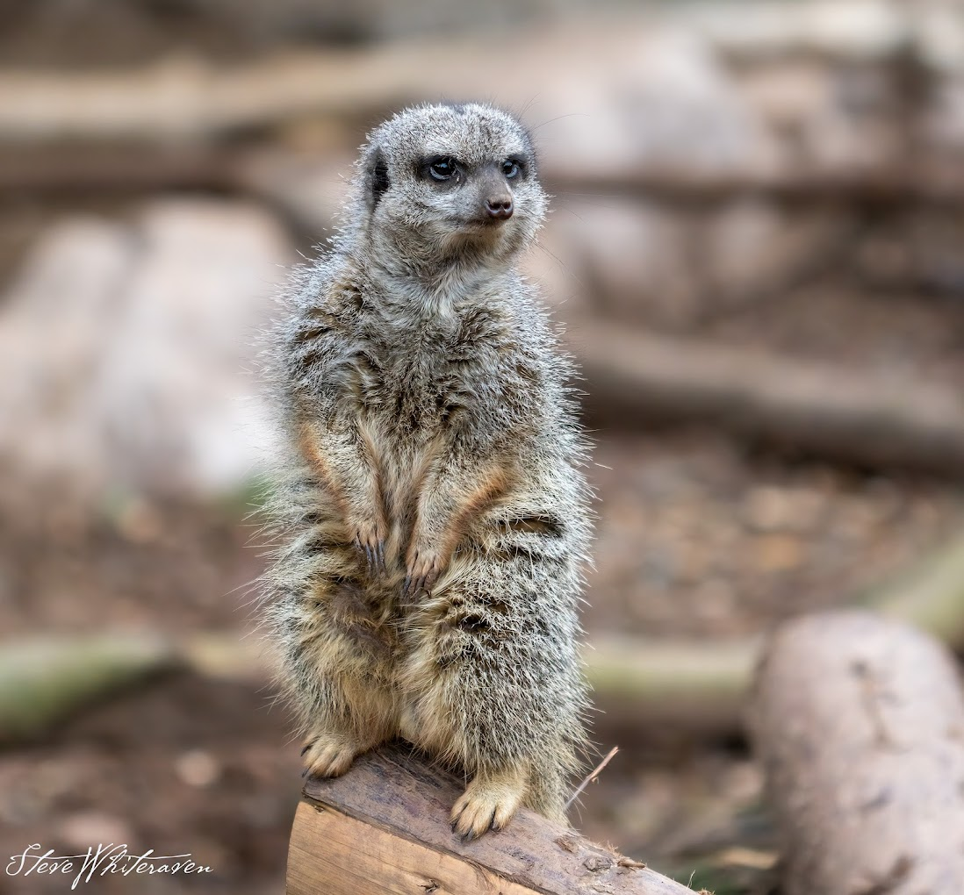
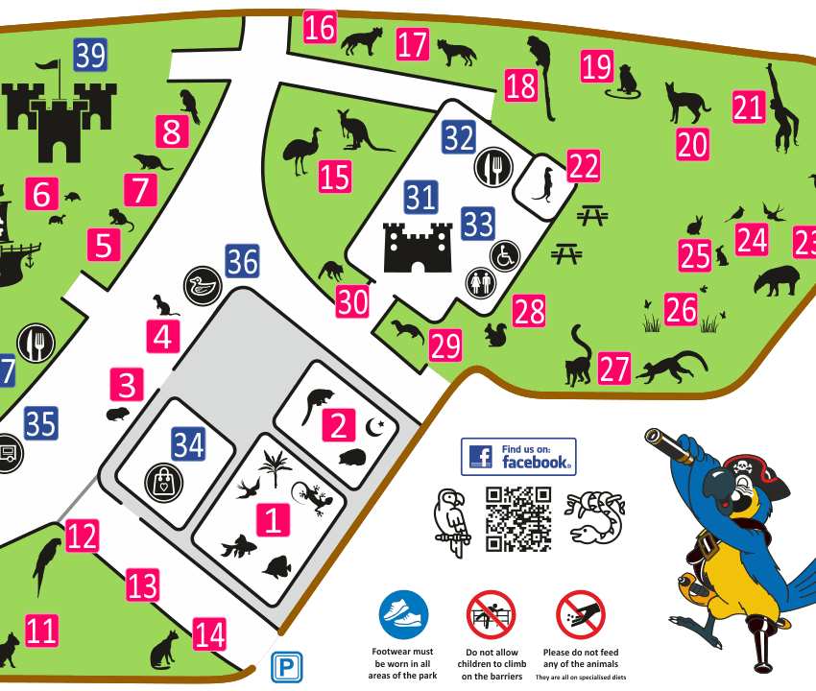
Tropiquaria Zoo
Tropiquaria is a zoo and wildlife park in Watchet, Somerset.
The former "Art Deco" BBC radio transmitter station was originally built in 1933 and houses a Tropical Hall, Nocturnal House and Aquarium.
Outside they have 4 acres of animal enclosures, along with two life size pirate ships, and adventure castle.

Slide 7
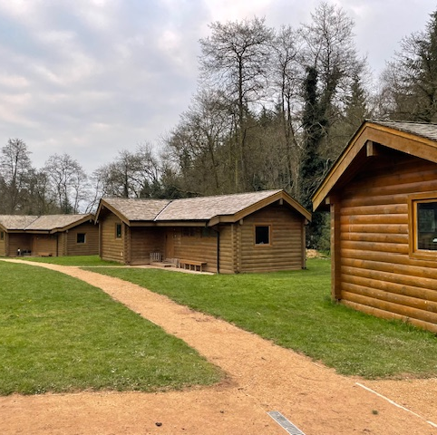
Cabins and Sleeping Arrangements
Cabins sleep up to eight children in two separate rooms.
Each cabin has a toilet and shower.
The cabins doors lock when shut, but can be opened up from inside and a code used for entry.
Children will be asked which two children they would like to share a cabin with. They will share with at least one of them.
Children will not be told who they will be sharing with until they arrive.

Slide 8
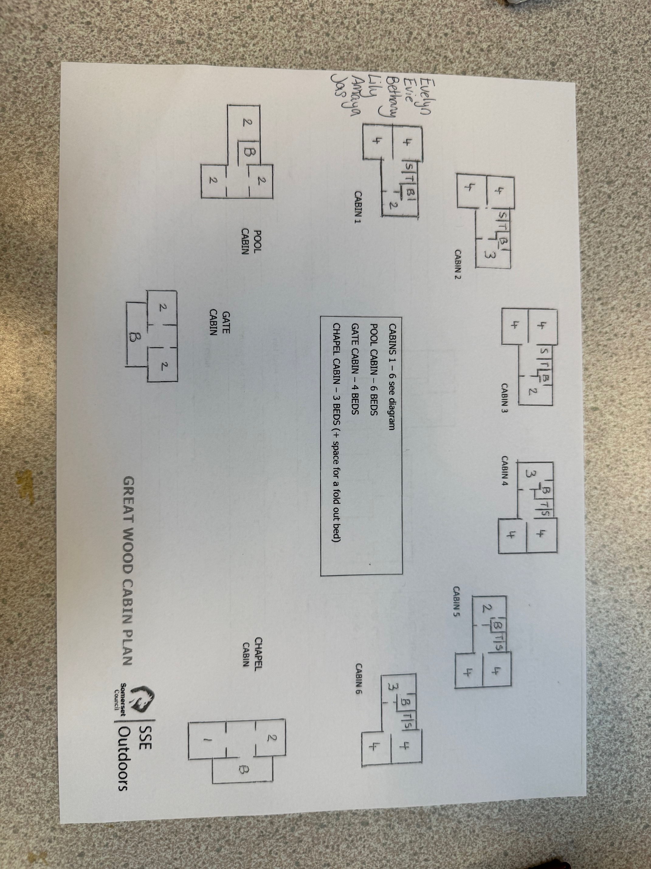

Slide 9
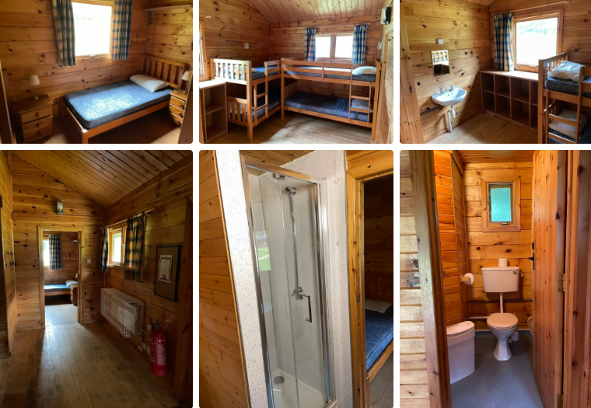

Slide 10
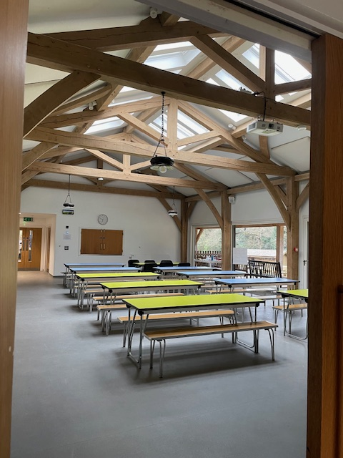
Menu
Breakfast: choice of cereal, toast, fruit and juice.
Lunch: choice of bread roll – ham, jam, tuna mayo, egg mayo or cheese, crisps, a chocolate bar and fruit.
Snacks: cake/biscuit and squash.
Evening meal: spaghetti bolognese, chicken curry, chicken nuggets and chips, pasta. Salad bar. Desserts: apple crumble and custard, ice-cream, choc ice, donuts.

Slide 11
Kit List | Tick
Lunch for Monday
Coat/Waterproofs (trousers and jacket)
Wellies and long socks
Strong walking shoes or trainers x2
Slippers/indoor shoes
Drinks bottle
Torch
All bedding:
Pillow and pillowcase
Sleeping bag or duvet
Bottom sheet
PJs (night attire)
Towel x 2
Toiletries (soap, hairbrush, shampoo)
Black bag for wet clothes
Kit List | Tick
Toothbrush and toothpaste
Small rucksack
Hat/cap – gloves/scarf if cold
Cuddly toy/book/notebook/pencil
£10 spending money in a named purse.
Sweets in a zip-lock bag
Medication
One change of clothes per day:
3 x pairs of trousers/joggers/leggings
3 x t-shirts
2 x hoodies/jumpers
2 x long sleeve tops
Underwear and socks – extra in case of accidents!

Slide 12

Do's and Don'ts
Do...
- Let us know about any medication your child will need for the trip
- Label everything before arrival. Pack with your child.
- Pack a teddy, reading book etc to help settle before bed
- Pack a camera but be aware it is the responsibility of the child
Don't...
- Pack any electrical devices, phones or computer games
- Pack any jewellery/ valuables

